Slide 1
FIFTY SHADES
OF
DUK

Slide 2




Slide 3
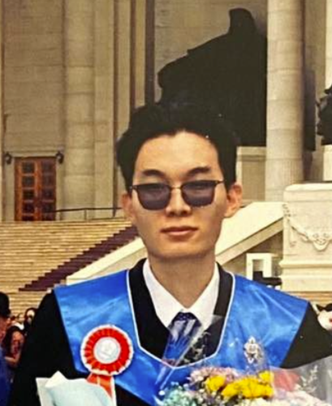


Slide 4
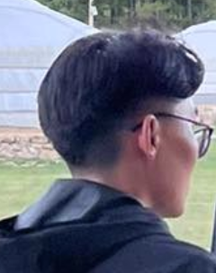



Slide 5


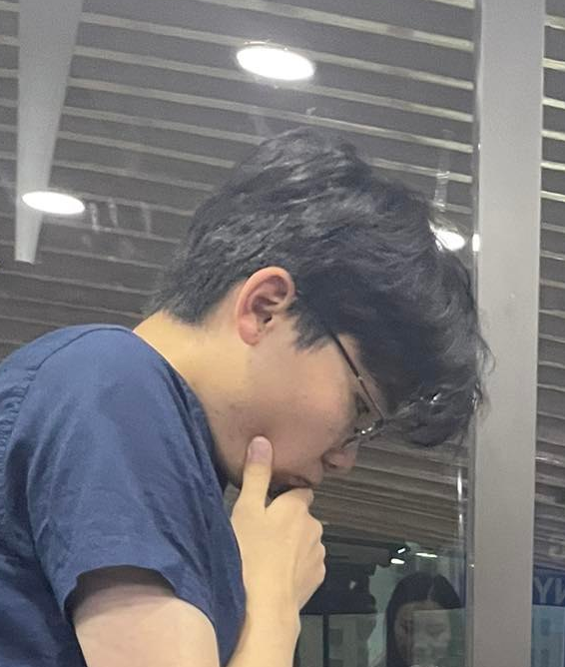

Slide 6




Slide 7




Slide 8
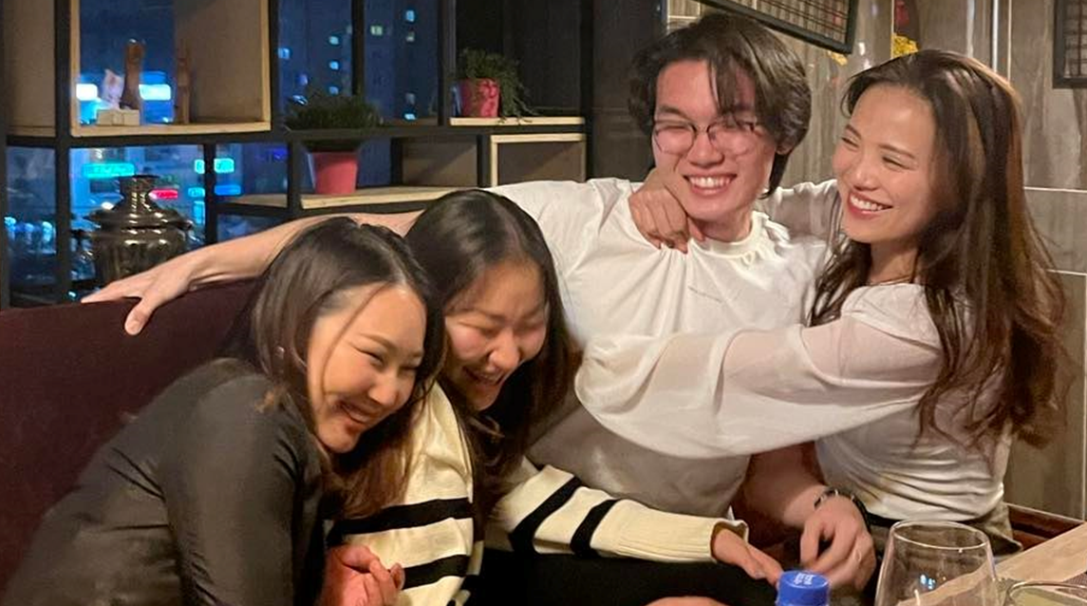

Slide 9
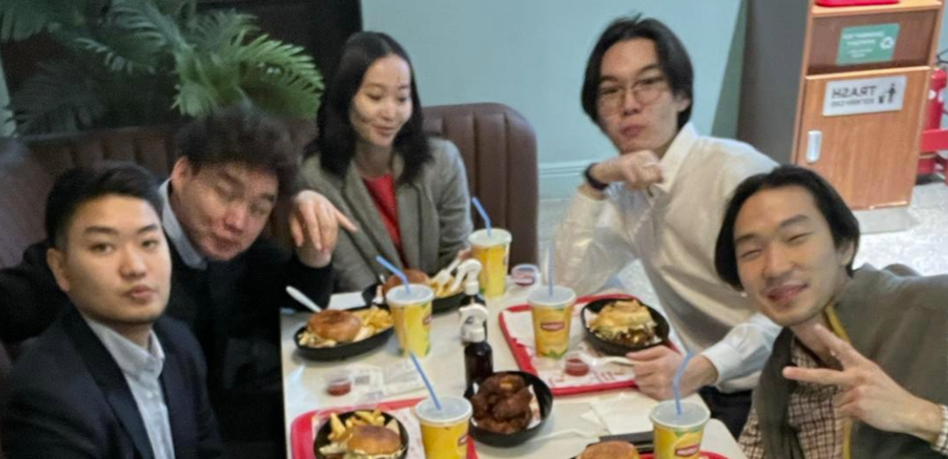

Slide 10


Slide 11




Slide 12

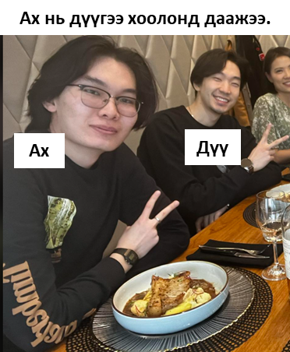

Slide 13




Slide 14
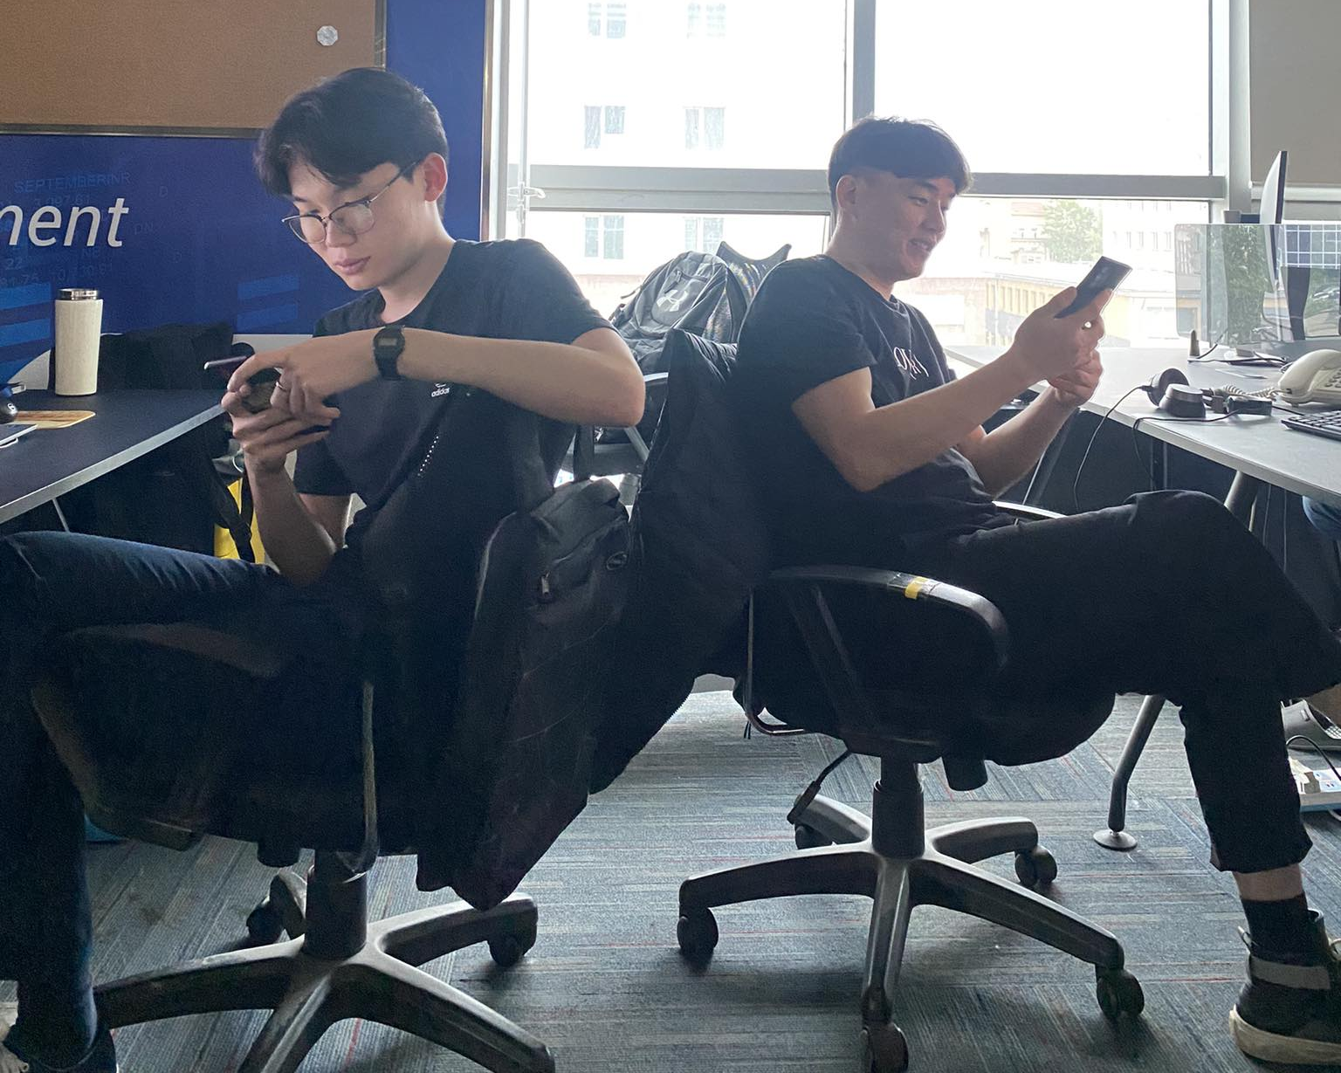

Slide 15




Slide 16



Slide 17




Slide 18
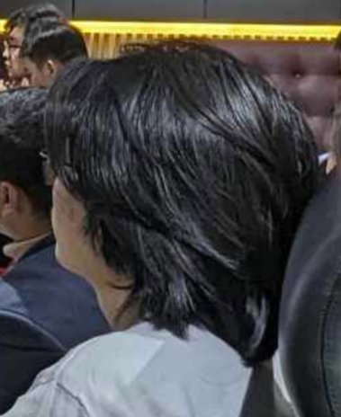


Slide 19




Slide 20




Slide 21


Slide 22



Slide 23




Slide 24
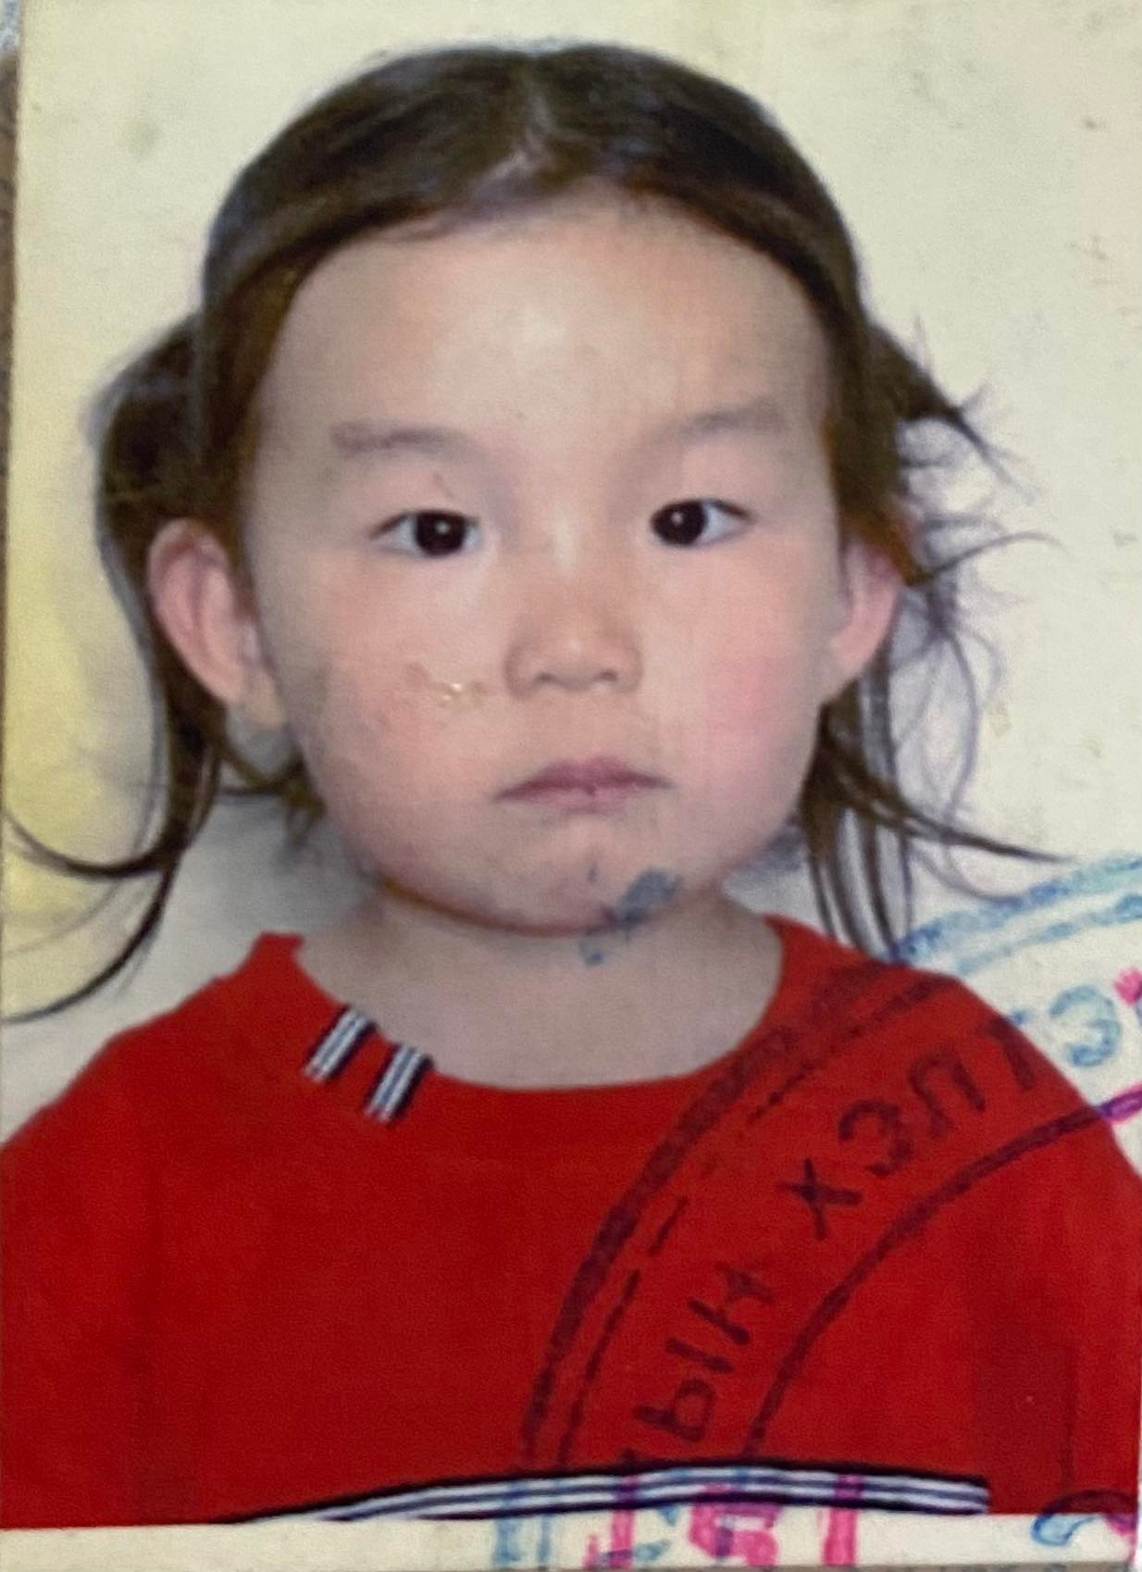
BONUS
#1

Slide 25
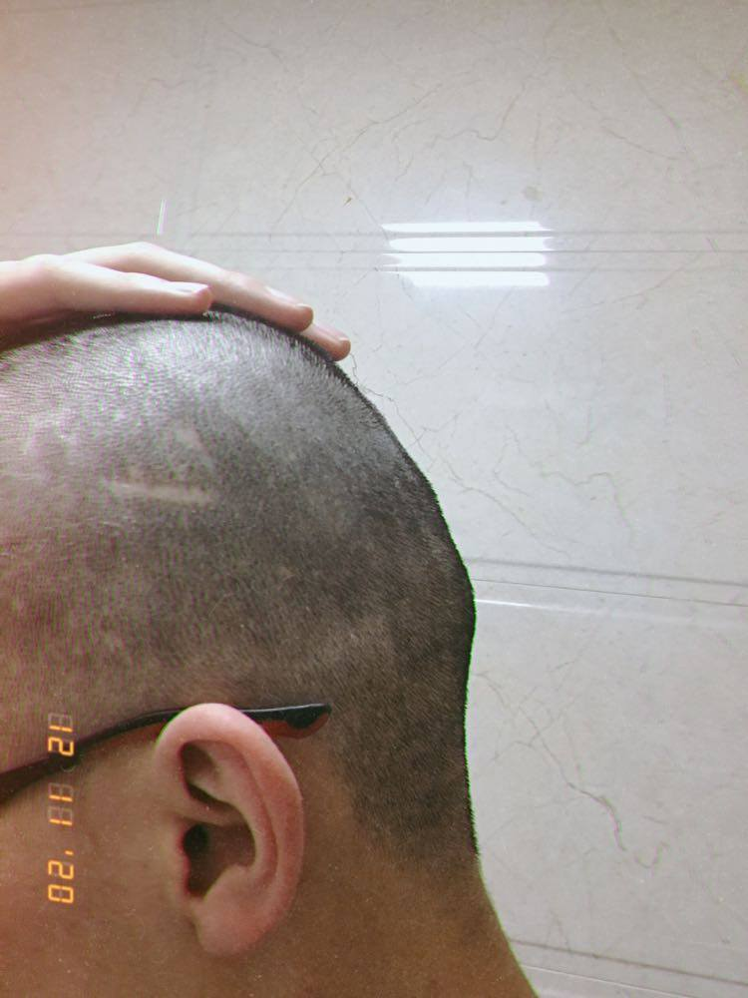

BONUS
#2

Slide 26
